Slide 1
Requirements Engineering

Slide 2
Objectives
Requirement (Definition and Introduction)
Requirement Engineering Process
Requirements elicitation and analysis
Requirements specification
The software requirements document (SRS)
User, System and domain requirements.
Types: Functional and Non-Functional requirements
Requirement Characteristics
Requirement Gathering Techniques
Requirements Validation
Requirements Management

Slide 3
What is a Requirement?
It may range from a high-level abstract statement of a service or of a system constraint to a detailed mathematical functional specification.
This is inevitable as requirements may serve a dual function
May be the basis for a bid for a contract - therefore must be open to interpretation;
May be the basis for the contract itself - therefore must be defined in detail;
Both these statements may be called requirements.

Slide 4
Requirements abstraction (Davis)
“If a company wishes to let a contract for a large software development project, it must define its needs in a sufficiently abstract way that a solution is not pre-defined. The requirements must be written so that several contractors can bid for the contract, offering, perhaps, different ways of meeting the client organization’s needs. Once a contract has been awarded, the contractor must write a system definition for the client in more detail so that the client understands and can validate what the software will do. Both of these documents may be called the requirements document for the system.”

Slide 5
Agile Methods and Requirements
Many agile methods argue that producing a requirements document is a waste of time as requirements change so quickly.
The document is therefore always out of date.
Methods such as XP use incremental requirements engineering and express requirements as ‘user stories’
This is practical for business systems but problematic for systems that require a lot of pre-delivery analysis (e.g. critical systems) or systems developed by several teams.

Slide 6
Requirement Engineering

Slide 7
Requirements Engineering
The requirements for a system are the descriptions of what the system should do
The process of establishing the services that the customer requires from a system and the constraints under which it operates and is developed.
The process of finding out, analyzing, documenting and checking these services and constraints is called requirements engineering (RE)

Slide 8
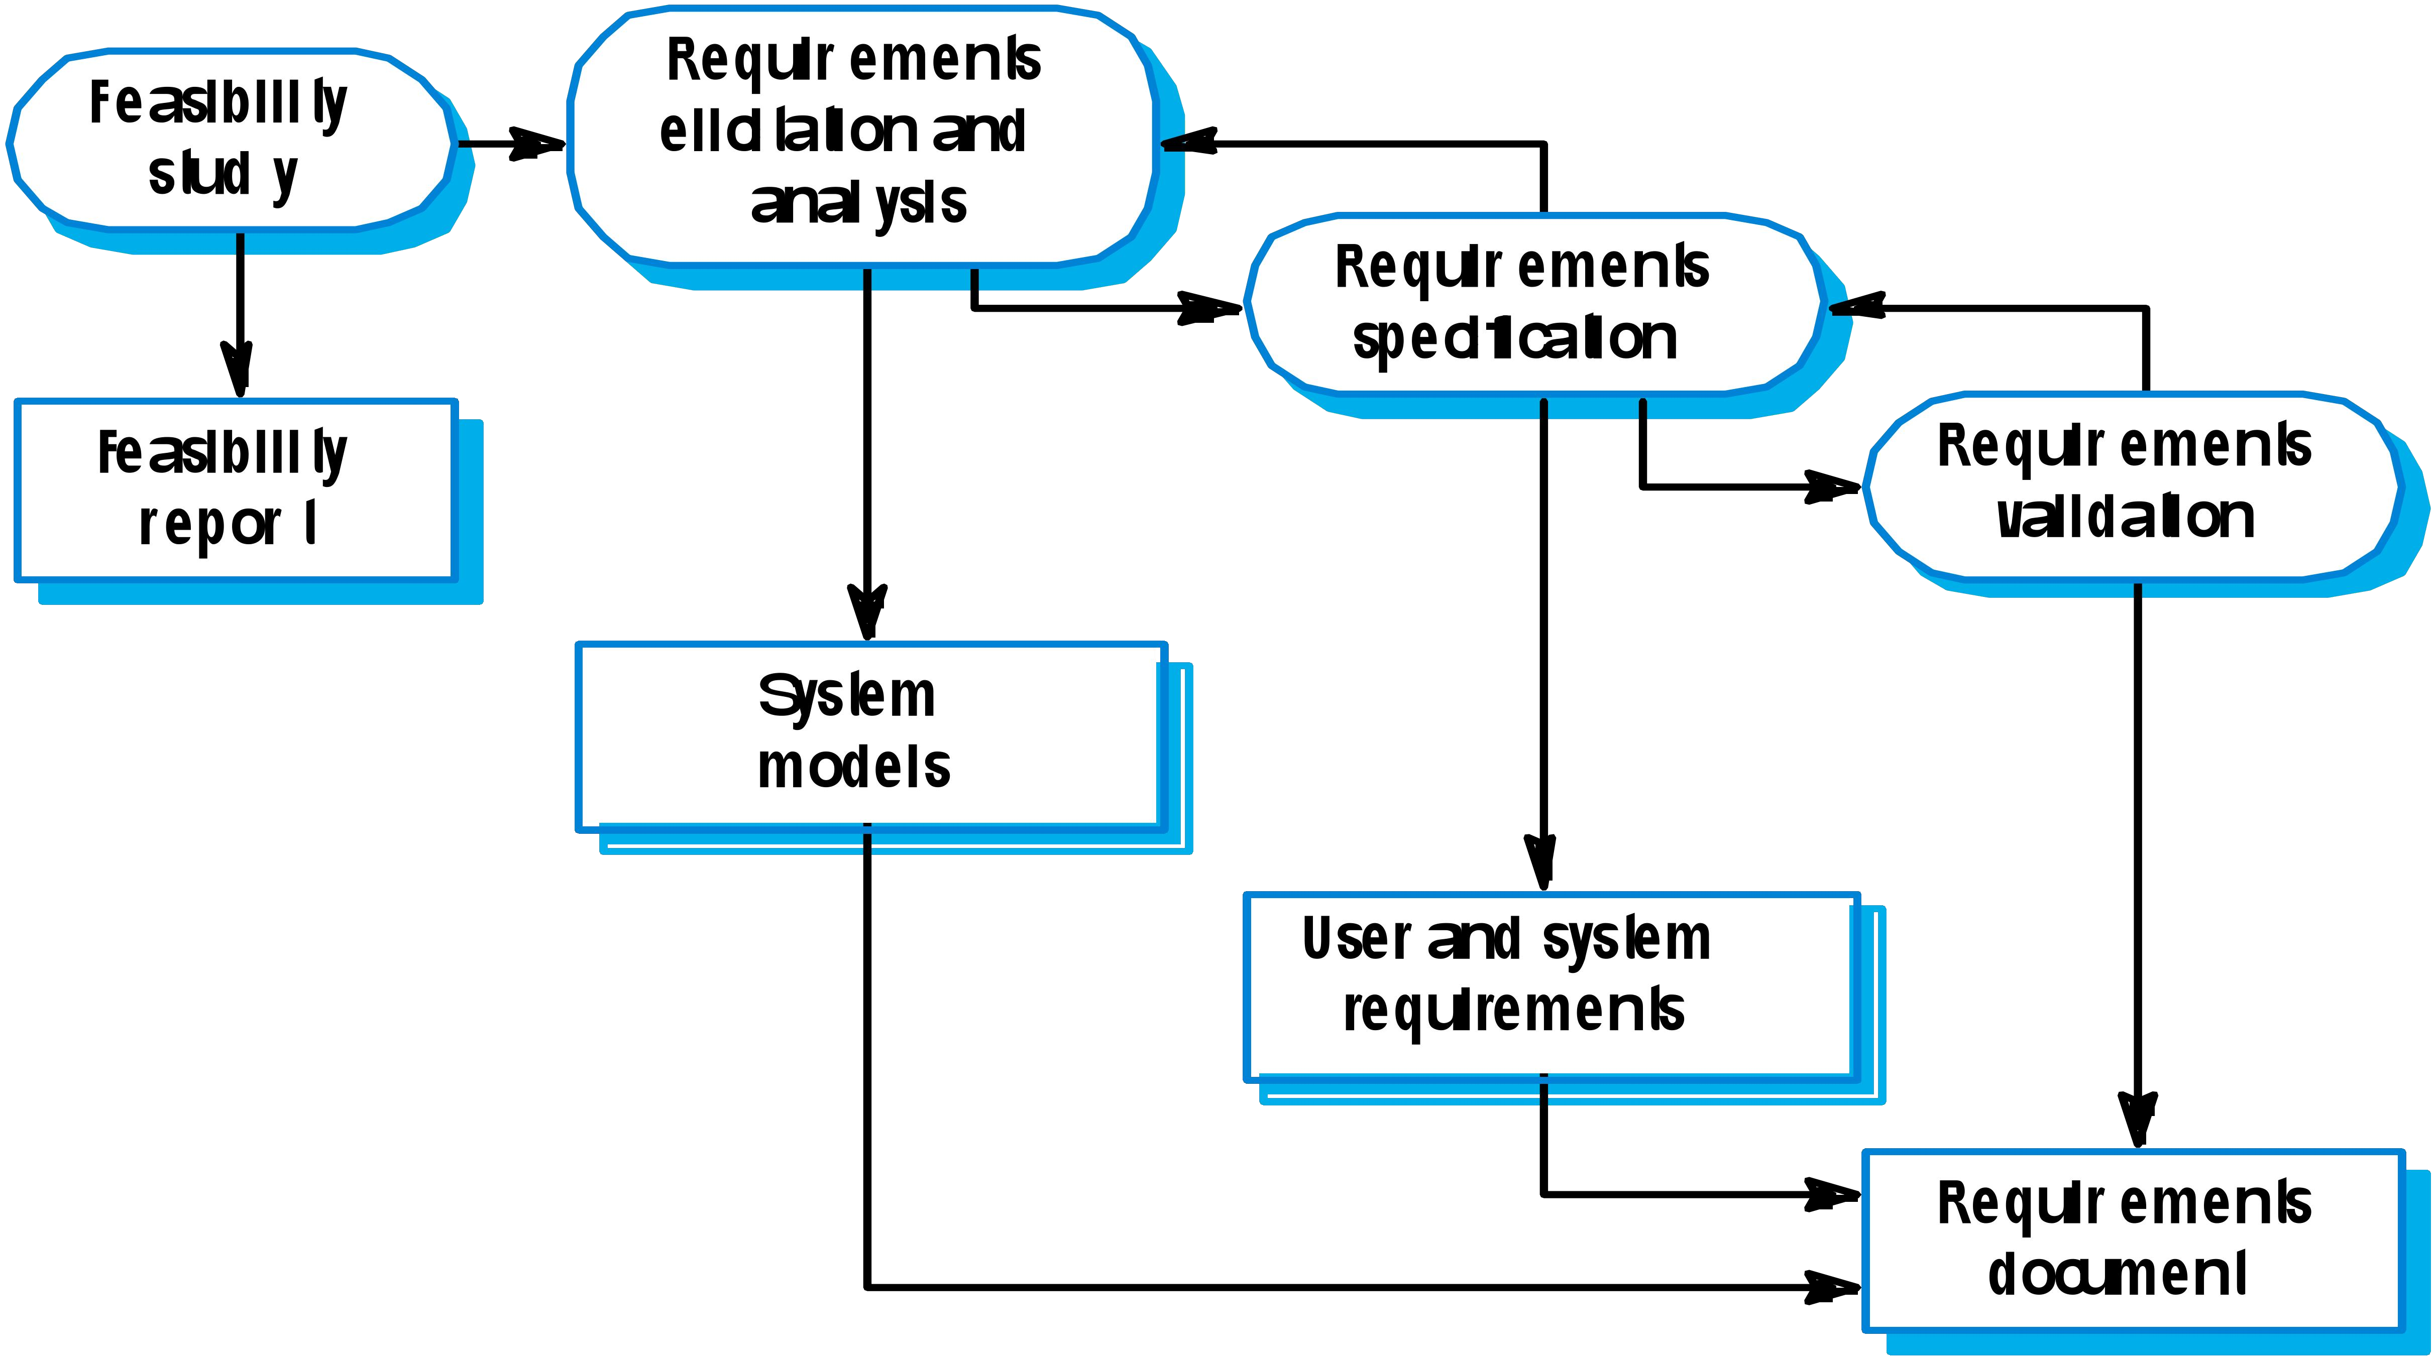
The Requirements Engineering Process
Example user requirement:
"The system should allow users to easily search for products by category and price range.
Example system requirement:
"The database must be able to handle 10,000 concurrent queries with a response time under 2 seconds

Slide 9
Requirements Engineering Process
The processes used for RE vary widely depending on the application domain, the people involved and the organization developing the requirements.
However, there are a number of generic activities common to all processes
Requirements Elicitation;
Requirements Analysis;
Requirements Specification;
Requirements Validation;
Requirements Management.

Slide 10
Steps in Requirement Phase
The requirements part of a project can be divided into several stages:
Analysis to establish the system's services, constraints, and goals by consultation with client, customers, and users.
Modelling to organize the requirements in a systematic and comprehensible manner.
Define, record, and communicate the requirements.

Slide 11
Requirements Elicitation and Analysis
Sometimes called requirements elicitation or requirements discovery.
Involves technical staff working with customers to find out about the application domain, the services that the system should provide and the system’s operational constraints.
May involve end-users, managers, engineers involved in maintenance, domain experts, trade unions, etc. These are called stakeholders.

Slide 12
Requirements Elicitation and Analysis
Software engineers work with a range of system stakeholders to find out about the application domain, the services that the system should provide, the required system performance, hardware constraints, other systems, etc.
Stages include:
Requirements discovery,
Requirements classification and organization,
Requirements prioritization and negotiation,
Requirements specification.

Slide 13
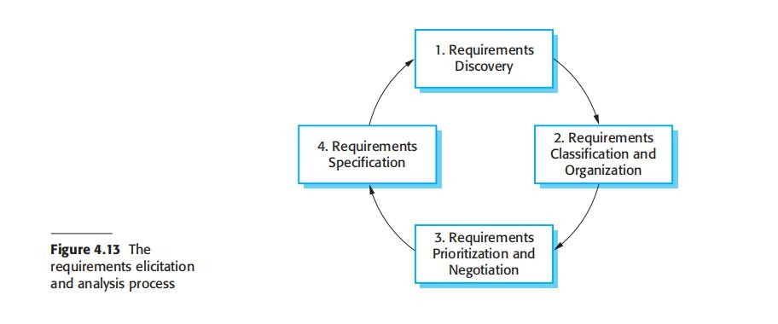
The Requirements Elicitation and Analysis Process

Slide 14
Requirements Elicitation and Analysis
Requirements discovery: This is the process of interacting with stakeholders of the system to discover their requirements. (Using requirements gathering techniques)
Requirements classification and organization: This activity takes the unstructured collection of requirements, groups related requirements, and organizes them into coherent clusters.
Requirements prioritization and negotiation: Inevitably, when multiple stakeholders are involved, requirements will conflict. This activity is concerned with prioritizing requirements and finding and resolving requirements conflicts through negotiation.
Requirements specification. The requirements are documented and input into the next round of the spiral. Formal or informal requirements documents may be produced.

Slide 15
Problems of Requirements Analysis
Stakeholders don’t know what they really want.
Stakeholders express requirements in their own terms.
Different stakeholders may have conflicting requirements.
Organisational and political factors may influence the system requirements.
The requirements change during the analysis process. New stakeholders may emerge and the business environment change.

Slide 16
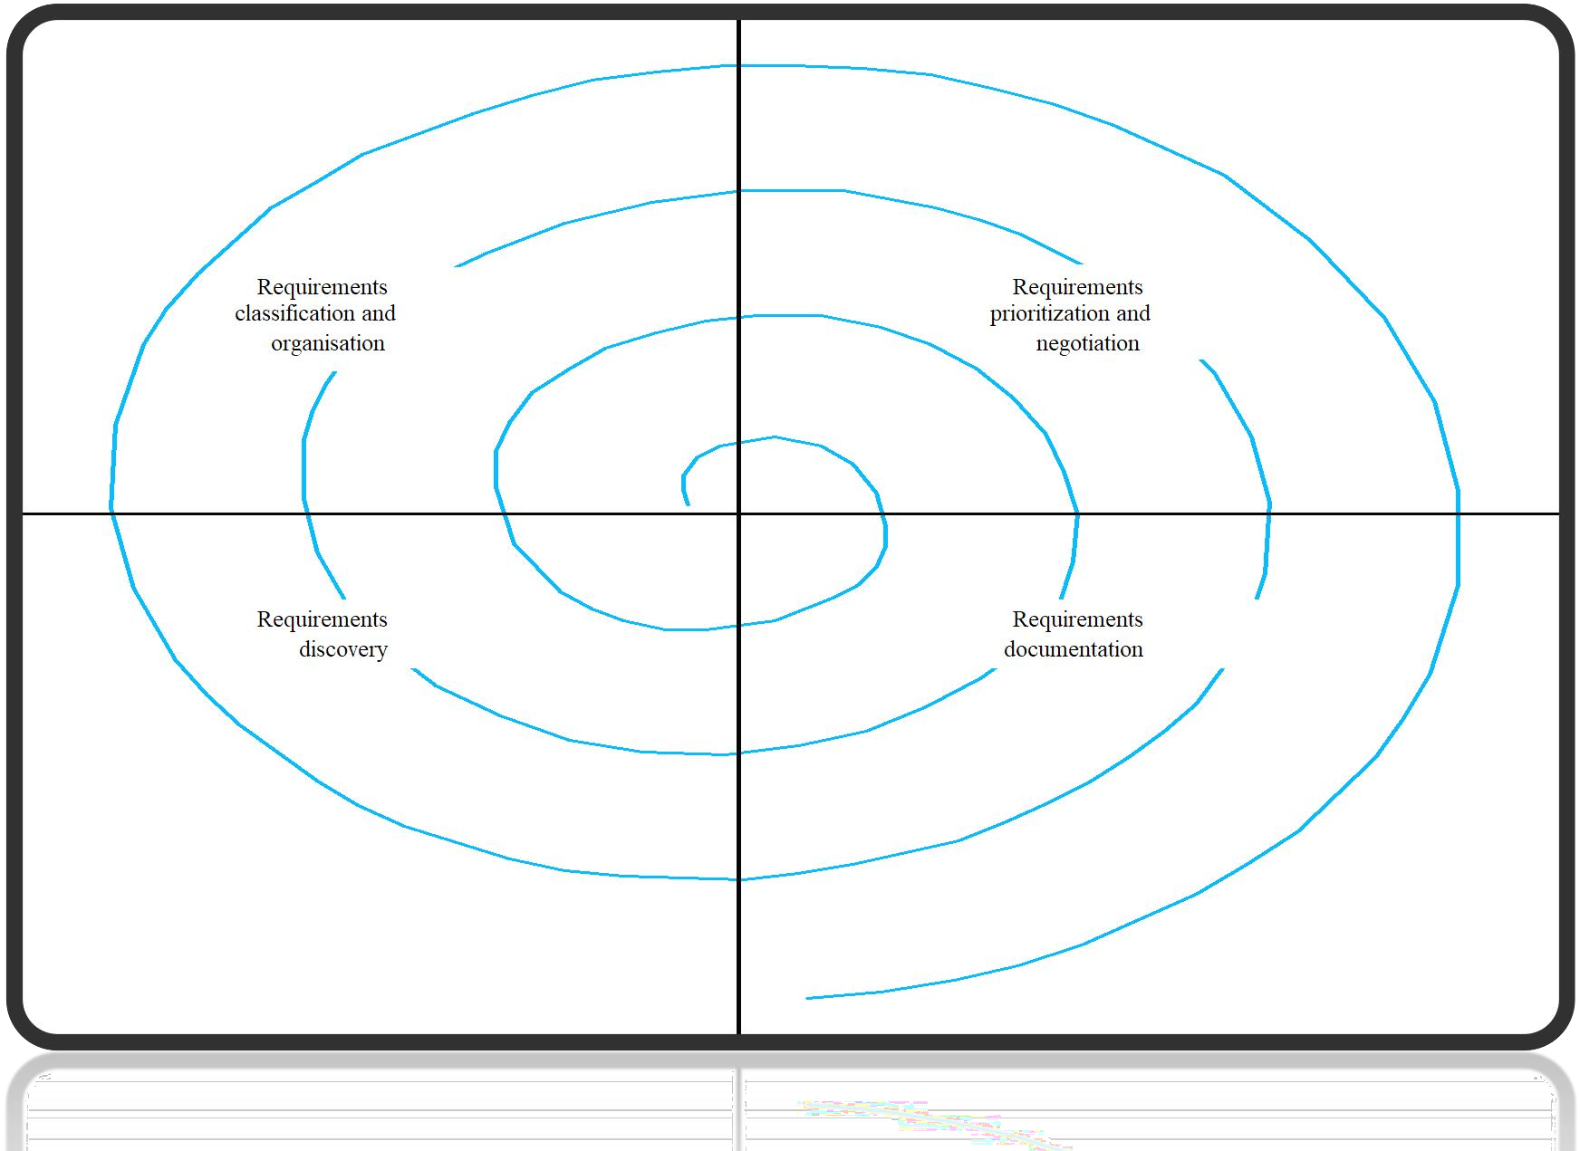
The Requirements Spiral

Slide 17
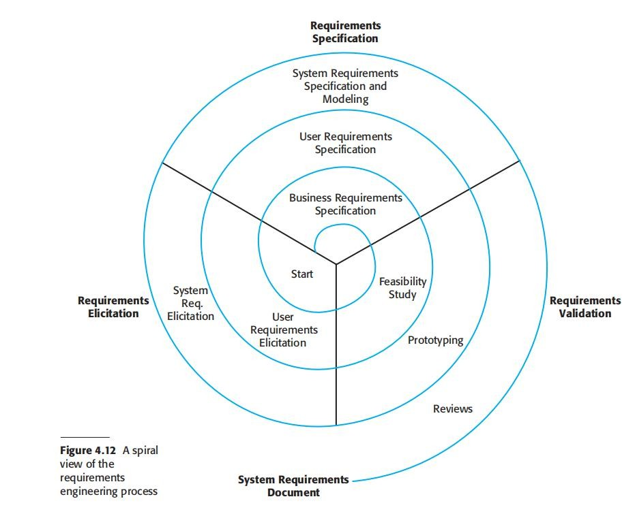
A spiral view of the requirements engineering process

Slide 18
Process activities
Requirements discovery
Interacting with stakeholders to discover their requirements. Domain requirements are also discovered at this stage.
Requirements classification and organization
Groups related requirements and organises them into coherent clusters.
Prioritization and negotiation
Prioritizing requirements and resolving requirements conflicts.
Requirements specification
Requirements are documented and input into the next round of the spiral.

Slide 19
Requirements and Design
In principle, requirements should state what the system should do and the design should describe how it does this.
•
In practice, requirements and design are inseparable
A system architecture may be designed to structure the requirements;
The system may inter-operate with other systems that generate design requirements;
The use of a specific architecture to satisfy non-functional requirements may be a domain requirement.

Slide 20
Requirements Specification

Slide 21
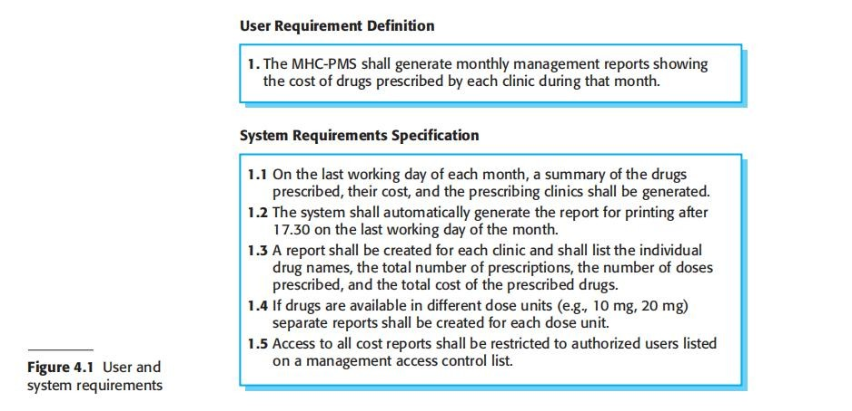
Requirements Specification

Slide 22
🞂Software Requirement Specification
Requirements specification Requirements specification is the process of writing down the user and system requirements in a requirements document.
A software requirements specification (SRS) is a complete description of the behavior of the system to be developed
A document that clearly and precisely describes, each of the essential requirements of the software and the external interfaces.
(functions, performance, design constraint, and quality attributes)
Each requirement is defined in such a way that its achievement is capable of being objectively verified by a prescribed method; for example inspection, demonstration, analysis, or test.

Slide 23
🞂​ The Software Requirements Document
The software requirements document is the official statement of what is required of the system developers.
Should include both a definition of user requirements and a specification of the system requirements.
It is NOT a design document. As far as possible, it should set of WHAT the system should do rather than HOW it should do it.

Slide 24
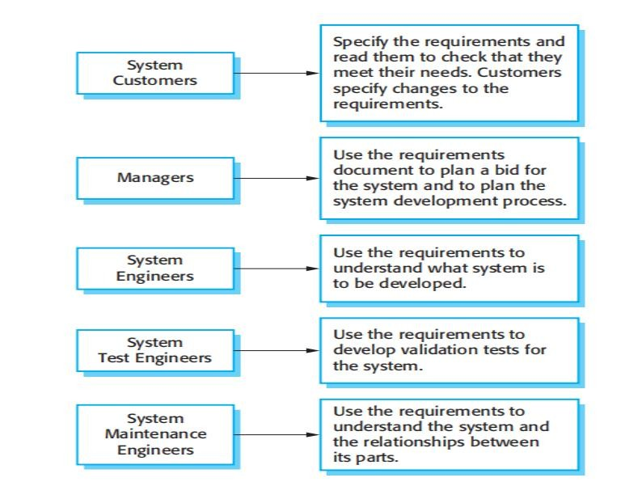
🞂​ Users of a Requirements Document

Slide 25
🞂​ Requirements Document Variability
Information in requirements document depends on type of system and the approach to development used.
Systems developed incrementally will, typically, have less detail in the requirements document.
Requirements documents standards have been designed e.g. IEEE standard. These are mostly applicable to the requirements for large systems engineering projects.
•
Discuss SRS document Template

Slide 26
🞂​ Natural language specification
Requirements are written as natural language sentences
supplemented by diagrams and tables.
Used for writing requirements because it is expressive, intuitive and universal. This means that the requirements can be understood by users and customers.

Slide 27
🞂​ Guidelines for writing requirements
Invent a standard format and use it for all requirements.
Use language in a consistent way. Use should for desirable requirements.
Use text highlighting to identify key parts of the requirement.
Avoid the use of computer jargon.
Include an explanation (rationale) of why a requirement is necessary.

Slide 28
🞂​ Problems with natural language
Lack of clarity
Precision is difficult without making the document difficult to read.
Requirements confusion
Functional and non-functional requirements tend to be mixed- up.
Requirements amalgamation
Several different requirements may be expressed together.

Slide 29
🞂​ Example requirements for the insulin pump
software system
3.2 The system will measure the blood sugar and deliver insulin, if required, every 10 minutes. (Changes in blood sugar are relatively slow so more frequent measurement is unnecessary; less frequent measurement could lead to unnecessarily high sugar levels.)
3.6 The system will run a self-test routine every minute with the conditions to be tested and the associated actions defined in Table 1. (A self-test routine can discover hardware and software problems and alert the user to the fact the normal operation may be impossible.)

Slide 30
🞂​ Form-based specifications
Definition of the function or entity.
Description of inputs and where they come from.
Description of outputs and where they go to.
Information about the information needed for the computation and other entities used.
Description of the action to be taken.
Pre and post conditions (if appropriate).
The side effects (if any) of the function.

Slide 31
Requirements Context:
🞂
System, User and Domain Requirements

Slide 32
🞂​ Types of Requirement (Context)
User Requirements
•
Statements in natural language plus diagrams of the services
the system provides and its operational constraints.
Written
for customers.
System Requirements
A structured document setting out detailed descriptions of the system’s functions, services and operational constraints. Defines what should be implemented so may be part of a contract between client and contractor.

Slide 33
🞂​ User and System Requirements

Slide 34
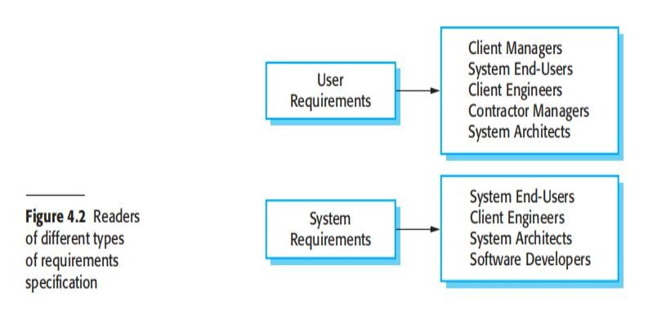
🞂​ Readers of Different types of Requirements
Specification

Slide 35
🞂​ Domain Requirements
The system’s operational domain imposes requirements on the system.
For example, a train control system has to take into account the braking characteristics in different weather conditions.
Domain requirements be new functional requirements, constraints on existing requirements or define specific computations.
If domain requirements are not satisfied, the system may be unworkable.

Slide 36
🞂​ Train protection system
This is a domain requirement for a train protection system:
The deceleration of the train will be computed as:
Dtrain = Dcontrol + Dgradient
where Dgradient is 9.81ms2 * compensated gradient/alpha and where the values of 9.81ms2 /alpha are known for different types of train.
It is difficult for a non- specialist to understand the implications of this and how i t interacts with other requirements.

Slide 37
Types of Requirements:
🞂
Functional Requirements and
Non-Functional Requirement

Slide 38
🞂​ Types of Requirements: Functional and Non-Functional Requirements
Functional requirements
Statements of services the system should provide, how the system should react to particular inputs and how the system should behave in particular situations.
May state what the system should not do.
Non-Functional requirements
Constraints on the services or functions offered by the system such as timing constraints, constraints on the development process, standards, etc.
Often apply to the system as a whole rather than individual features or services.
In other words, a non-functional requirement will describe how a system should behave and what limits there are on its functionality.

Slide 39
🞂​ Functional Requirements
What the system should do
Describe functionality or system services.
Depend on the type of software, expected users and the type of system where the software is used.
Functional user requirements may be high-level statements of what the system should do.
Functional system requirements should describe the system services in detail.

Slide 40
🞂​ Functional Requirements for the MHC-PMS
A user will be able to search the appointments lists for all clinics.
The system will generate each day, for each clinic, a list of patients who are expected to attend appointments that day.
Each staff member using the system will be uniquely identified by his or her 8-digit employee number.

Slide 41
🞂​ Non-functional requirements
These define system properties and constraints
e.g. reliability, response time and storage requirements.
Constraints on the system implementation
e.g. I/O device capability, data representations, etc.
Constrain characteristics of the system as a whole
such as performance, security, or availability
•
Non-functional requirements may be more critical than functional
requirements. If these are not met, the system may be useless
.
For example, if an aircraft system does not meet its reliability requirements, it will not be certified as safe for operation
if an embedded control system fails to meet its performance requirements, the control functions will not operate correctly

Slide 42
🞂​ Non-functional requirements implementation
Non-functional requirements may affect the overall architecture of a system rather than the individual components.
For example, to ensure that performance requirements are met, you may have t o organize t he system t o m i n i m i ze communications between components.
A single non- functional requirement, such as a security requirement, may generate a number of related functional requirements that define system services that are required.
It may also generate requirements that restrict existing requirements.

Slide 43
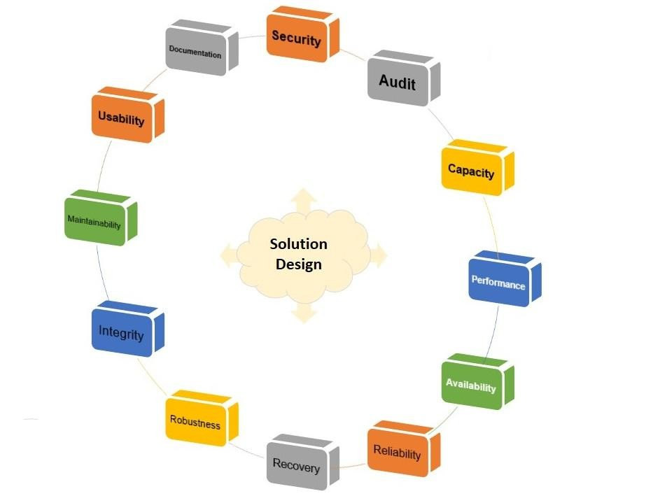
🞂​ Non-functional Requirements

Slide 44
🞂​ Non-functional Requirements
The FURPS Model ( Functionality, Usability, Reliability, Performance, and Supportability)
Typical non-functional requirements include:
Performance– for example: response time, throughput, utilization, static volumetric
Scalability
Capacity
Availability
Reliability
Recoverability
Maintainability
Serviceability
Security
Regulatory
Manageability
Environmental
Data Integrity
Usability
Visit: https://requirementsquest.com/nonfunctional-requirement-examples/
Software Engineering Concepts-CSC291-FALL-2022 Mr. Tehseen Riaz Abbasi
Interoperability

Slide 45
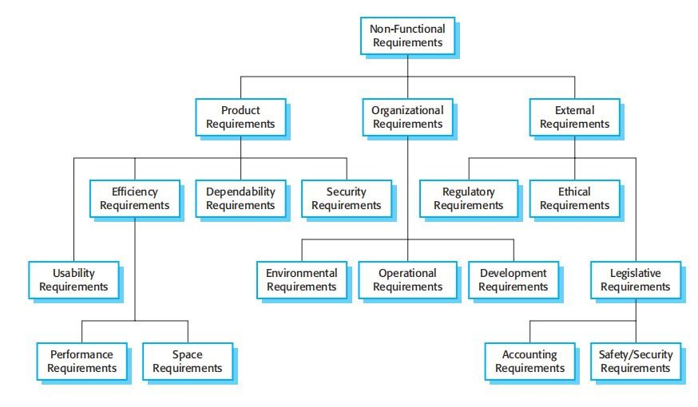
🞂​ Types of Non-Functional Requirement

Slide 46
🞂​ Non-Functional Requirement Classifications
Product requirements
Requirements which specify that the delivered product must behave in a particular way e.g. execution speed, reliability, etc.
Organizational requirements
Requirements which are a consequence of organizational policies and procedures e.g. process standards used, implementation requirements, etc.
External requirements
Requirements which arise from factors which are external to the system and its development process e.g. interoperability requirements, legislative requirements, etc.

Slide 47
🞂​ Examples of non-functional requirements in the
MHC-PMS
Product requirement
The MHC-PMS will be available to all clinics during normal working hours (Mon–Fri, 0830–17.30). Downtime within normal working hours will not exceed five seconds in any one day.
Organizational requirement
Users of the MHC-PMS system will authenticate themselves using their health authority identity card.
External requirement
The system will implement patient privacy provisions as set out in HStan-03- 2006-priv.

Slide 48
🞂​ NFR- Goals and Requirements
A common problem with non-functional requirements is that users or customers often propose these requirements as general goals
Non-functional requirements may be very difficult to state precisely and imprecise requirements may be difficult to verify.
Goal
A general intention of the user such as ease of use.
Verifiable non-functional requirement
A statement using some measure that can be objectively tested.
Goals are helpful to developers as they convey the intentions of the system users.

Slide 49
🞂​ Usability requirements
How a manager might express usability requirements as GOAL
The system should be easy to use by medical staff and should be organized in such a way that user errors are minimized. (Goal)
How the goal could be expressed as a ‘testable’ nonfunctional requirement
Medical staff will be able to use all the system functions after four hours of training.
After this training, the average number of errors made by experienced users will not exceed two per hour of system use. (Testable non- functional requirement)

Slide 50
🞂​ Metrics for Specifying Non-Functional
Requirements
Property | Measure
Speed | Processed transactions/second User/event response time Screen refresh time
Size | Mbytes Number of ROM chips
Ease of use | Training time Number of help frames
Reliability | Mean time to failure Probability of unavailability Rate of failure occurrence Availability
Robustness | Time to restart after failure Percentage of events causing failure Probability of data corruption on failure
Portability | Percentage of target dependent statements Number of target systems

Slide 51
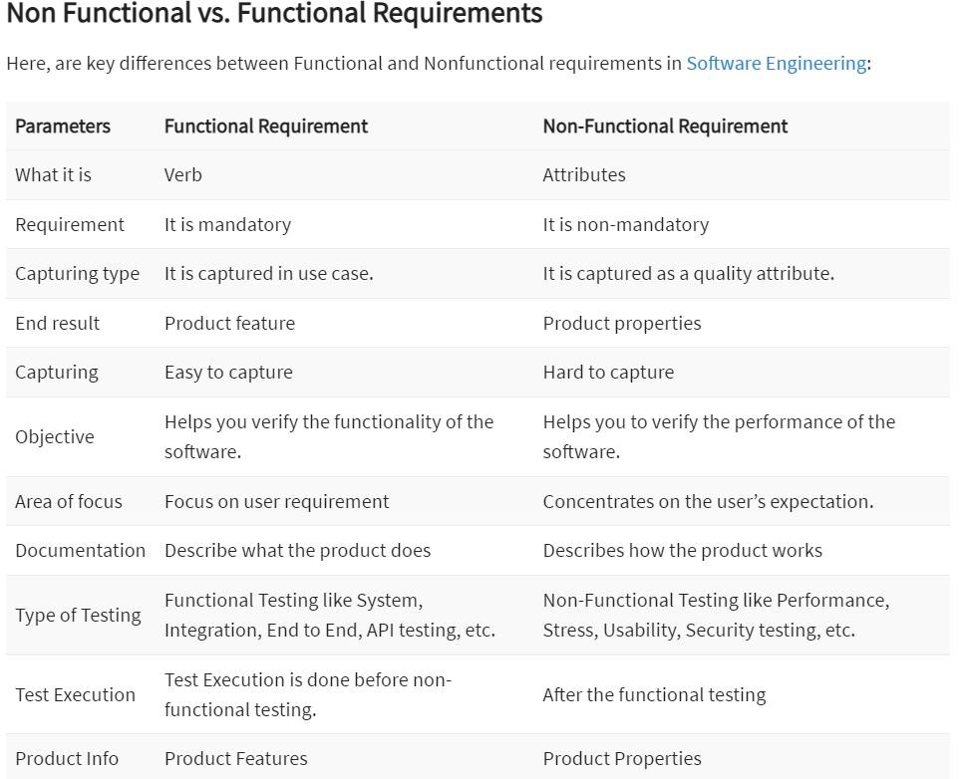
Functional and Non-Functional Requirements
🞂

Slide 52
🞂​ Requirements Characteristics

Slide 53
🞂​ Requirements Imprecision
Problems arise when requirements are not precisely stated.
Ambiguous requirements may be interpreted in different ways by developers and users.
Consider the term ‘search’ in requirement 1
User intention – search for a patient name across all appointments in all clinics;
Developer interpretation – search for a patient name in an individual clinic. User chooses clinic then search.

Slide 54
🞂​ Requirements Completeness and Consistency
In principle, requirements should be both complete and consistent.
Complete
They should include descriptions of all facilities required.
Consistent
There should be no conflicts or contradictions in the descriptions of the system facilities.
In practice, it is impossible to produce a complete and consistent requirements document.

Slide 55
🞂​ Requirements Characteristic
Good requirements should have the following characteristics:
Unambiguous
Testable (verifiable)
Clear (concise, terse, simple, precise)
Correct
Understandable
Feasible (realistic, possible)
Independent
Atomic
Necessary
Implementation-free (abstract)

Slide 56
🞂​ Good and Bad Requirements
R1: Only authorized persons are allowed to enter the building.
R2: The doorbell button will be blue, round, and with a diameter of 20 mm.
R1 is a goal,
R2 is a detailed specification
R2 is in fact three different requirements.

Slide 57
🞂​ Good and Bad Requirements - Example 2
R4: The system will play the sound ’alarm’ when the door is opened.
R4: The system will play the sound ’C:\alarm.wav’ once, at the highest volume setting in the main speaker for the building when the door opens.

Slide 58
Good and Bad Requirements - Example 3
R5: The system will respond quickly to user interaction.
R5: The system will respond to user interaction within maximum 2 seconds, minimum 0.2 seconds, average 1 second (with a CPU load of 0.5).

Slide 59
Good and Bad Requirements - Example 4
R6: There are four classes of users in the system: Maintainer, Administrator, Normal User, Guest.
R7: A Guest User is able to enter areas X1, X2, and X3.
R8: A Normal User is able to enter all areas in the building.
R9: An Administrator is a Normal User who also have the right to add/modify/delete users in the system.
R10: A Maintainer is a Guest who is also able to enter area X99 and perform backups, view system logs, and add/modify/delete users.

Slide 60
🞂​ Example 4 cont…..
R6: Users and their access rights are listed in Table 1
User Class | Area X1 | ……….. | Area X99 | Add/modify/ delete users | Backups | View Logs
Guest | Yes |  | No | No | No | No
Normal user | Yes |  | Yes | No | No | No
Administrator | Yes |  | Yes | Yes | No | Yes
Maintainer | NO |  | Yes | Yes | Yes | Yes

Slide 61
🞂​ Good and Bad Requirements - Example 5
R11: When a user enters a correct code, the door will open.
R11: When a user enters the code associated with him/her on keypad K2 the door D2 will unlock and remain unlocked for 30 seconds.

Slide 62
🞂​ Good and Bad Requirements - Example 6
R12: When a user has entered the building, this will be registered in the entry log and the user’s computer will be booted.
R12: When a user has entered the building, this will be registered in the entry log.
R13: When a user has entered the building, the user’s computer will be booted.
R12: The system will register in the entry log when a user has entered the building.

Slide 63
🞂​ Requirements Gathering Techniques

Slide 64
🞂​ Requirements Discovery - Elicitation
The process of gathering information about the required and existing systems and distilling the user and system requirements from this information.
Interaction is with system stakeholders from managers to external regulators.
Sources of information may include documentation, system stakeholders, and specifications of similar systems
Systems normally have a range of stakeholders.

Slide 65
🞂​ Stakeholders in the MHC-PMS
Patients whose information is recorded in the system.
Doctors who are responsible for assessing and treating patients.
Nurses who coordinate the consultations with doctors and administer some treatments.
Medical receptionists who manage patients’ appointments.
IT staff who are responsible for installing and maintaining the system.

Slide 66
Techniques of Eliciting Requirements
Analysts can employ several techniques to elicit the requirements from the customer.
Survey/Questionnaire
Focus groups (requirements workshops) and creating requirements lists.
Naturalistic observation
Document Analysis
Interviews
Ethnography
Prototyping
Brainstorming
Scenarios
Use cases
Combination of these methods will be good choice.

Slide 67
🞂​ Questionnaires
Questionnaires: Series of questions designed to elicit specific information
from us. The questions may require different kinds of answers: some require a simple Yes/No, others ask us to choose from a set of pre-supplied answers.
SurveyMonkey
Popular solution to let you design and distribute questionnaires
Runs ‘in the cloud’
Lime Survey
A free online tool that can be installed directly onto the researcher’s
system, thus avoiding storage of data in the cloud (better control of confidential data)

Slide 68
🞂​ Focus groups and workshops
Focus groups and workshops: Interviews tend to be one on one, and elicit
only one person’s perspective. It can be very revealing to get a group of stakeholders together to discuss issues and requirements.
Focus Group: For the focus group following are the key things:
Discussion is focused around a topic.
Facilitator already knows what he wanted to ask from each
participants and develop a discussion guide accordingly.
Facilitator develops discussion guide based on experience of each
participants with the product.
Based on discussion guided by discussion guide product requirements are identified.

Slide 69
🞂​ Naturalistic Observation
Naturalistic Observation: It can be very difficult for humans to explain what they do or to even describe accurately how they achieve a task.
Spend time with stakeholders in their day-to-day tasks, observing work as it happens
Gain insights into stakeholders’ tasks
Good for understanding the nature and context of the tasks
But it requires time and commitment
from a member of the design team, and it can result in a huge amount of data
Ethnography is one form : entire class devoted to this.
Directly Observing Users
Serves as a good method to supplement interviews
Often difficult to obtain unbiased data
People often work differently when being observed
Be cognizant of normal and abnormal conditions, e.g. entering an order vs. the end of quarter sales report

Slide 70
🞂​ Document Analysis
Studying documentation: Procedures and rules are often written down in a
manual and these are a good source of data about the steps involved in an activity and any regulations governing a task.
Four types of useful documents
Written work procedures
Describes how a job is performed
Includes data and information used and created in the process of performing the job or task
Business form
Explicitly indicate data flow in or out of a system
Report
Enables the analyst to work backwards from the report to the data that generated it
Description of current information system

Slide 71
🞂​ Interviewing
Interviews: Interviews involve asking someone a set of questions. Often interviews are face- to-face, but they don’t have to.
•
Interviews are good for getting an overall understanding of what stakeholders do, how they
might interact with the new system, and the difficulties that they face with current systems.
Formal or informal interviews with stakeholders are part of most RE processes.
Types of interview
Closed interviews based on pre-determined list of questions
Open interviews where various issues are explored with stakeholders.
Effective interviewing
Be open-minded, avoid pre-conceived ideas about the requirements and are willing to listen to stakeholders.
Prompt the interviewee to get discussions going using a springboard question, a requirements proposal, or by working together on a prototype system.

Slide 72
🞂​ Interviews in practice
•
Normally a mix of closed and open-ended interviewing.
Interviews are good for getting an overall understanding of what stakeholders do and how they might interact with the system.
Interviews are not good for understanding domain requirements
Requirements engineers cannot understand specific domain terminology;
Some domain knowledge is so familiar that people find it hard to articulate or think that it isn’t worth articulating.

Slide 73
🞂​ Ethnography
Ethnography is an observational technique that can be used to
understand operational processes and help derive support requirements for these processes. An analyst immerses himself
or herself in the working environment where the system will |  | be
used.
Ethnography is an observational technique that can be used to understand operational processes and help derive requirements for these processes. It helps discover the implicit system requirements that reflect the actual way that people work rather than formal processes defined by the organization.

Slide 74
🞂​ Ethnography
Particularly useful for discovering the following two types of requirements:
Requirements that are derived from the way in which people actually work, rather than the way in which process definitions say they ought to work.
For example, air traffic controllers may switch off a conflict alert system that detects aircraft with intersecting flight paths, even though normal control procedures specify that it should be used. They deliberately put the aircraft on conflicting paths for a short time to help manage the airspace. Their control strategy is designed to ensure that these aircraft are moved apart before problems occur and they find that the conflict alert alarm distracts them from their work.
Requirements that are derived from cooperation and awareness of other people’s activities.
For example, air traffic controllers may use an awareness of other controllers’ work to predict the number of aircrafts that will be entering their control sector. They then modify their control strategies depending on that predicted workload. Therefore, an automated ATC system should allow controllers in a sector to have some visibility of the work in adjacent sectors.

Slide 75
🞂​ Ethnography
A social scientists spends a considerable time observing and analyzing how people actually work.
People do not have to explain or articulate their work.
Social and organizational factors of importance may be observed.
Ethnographic studies have shown that work is usually richer and more complex than suggested by simple system models.

Slide 76
🞂​ Focused Ethnography
Developed in a project studying the air traffic control process
Combines ethnography with prototyping
Prototype development results in unanswered questions which focus the ethnographic analysis.
The problem with ethnography is that it studies existing practices which may have some historical basis which is no longer relevant.

Slide 77
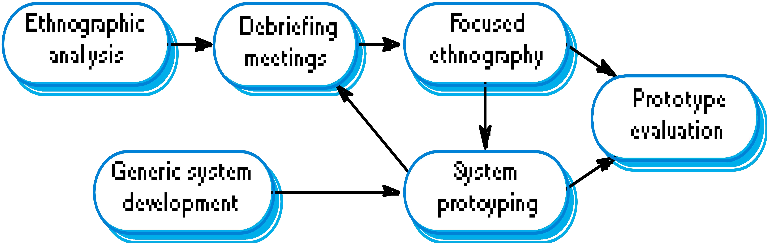
🞂​ Ethnography and Prototyping

Slide 78
🞂​ Scope of Ethnography
Requirements that are derived from the way that people actually work rather than the way I which process definitions suggest that they ought to work.
Requirements that are derived from cooperation and awareness of other people’s activities.

Slide 79
🞂​ Prototyping
Repetitive process
Elementary version of system is built
Replaces or augments SDLC
Goal: to develop concrete specifications for ultimate system
Quickly converts requirements to working version of system
Once the user sees requirements converted to system, will ask for modifications or will generate additional requests
Is prototyping useful in any of these cases?
User requests are not clear
Few users are involved in the system
Designs are complex and require concrete form
History of communication problems between analysts and users
Tools are readily available to build prototype

Slide 80
🞂​ Brainstorming
Brainstorming is a situation where a group of people meet to generate new ideas and solutions around a specific domain of interest by removing inhibitions. People are able to think more freely, and they suggest as many spontaneous new ideas as possible. All the ideas are noted down without criticism and after the brainstorming session the ideas are evaluated
Individual Brainstorming
Group Brainstorming

Slide 81
🞂​ Task descriptions
Scenarios
An informal narrative story of users
Natural way to explain
Scenarios can be particularly useful for adding detail to an outline requirements description.
Use cases
Show interaction with a system
Show detailed understanding of the interaction
Essential use cases
Improvement of use cases
Often used in combination

Slide 82
🞂​ Scenarios And Use Cases

Slide 83
🞂​ Scenarios
•
Scenarios are real-life examples of how a system can be used.
They should include
A description of the starting situation;
A description of the normal flow of events;
A description of what can go wrong;
Information about other concurrent activities;
A description of the state when the scenario finishes.

Slide 84
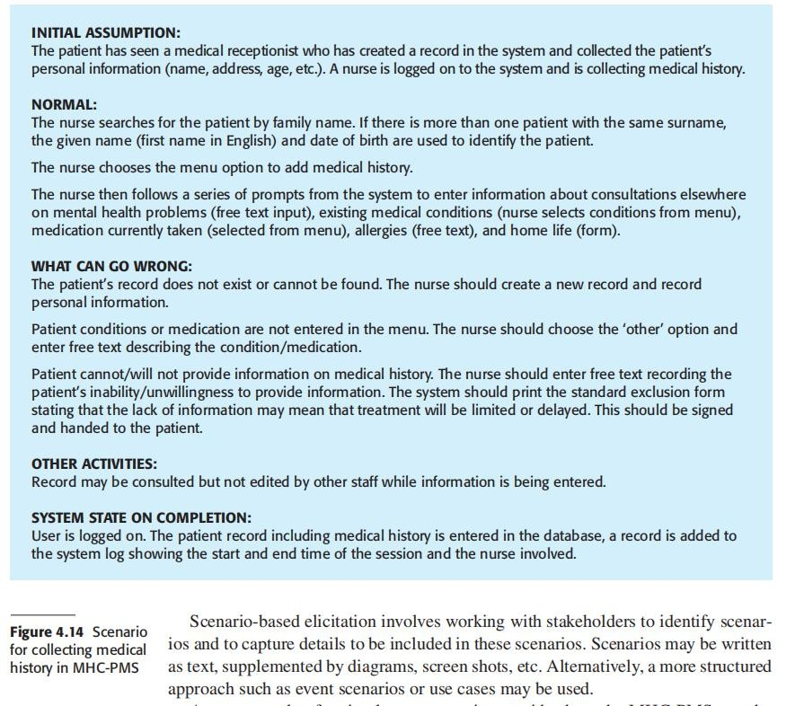
🞂​ Scenario for collecting medical history in MHC-PMS

Slide 85
🞂​ Use Cases

Slide 86
🞂​ Use cases
•
A use case identifies the actors involved in an interaction and
names the type of interaction. Use cases are documented using
a high-level use case diagram.
Use-cases are a scenario based technique in the UML which identify the actors in an interaction and which describe the interaction itself.
A set of use cases should describe all possible interactions with the system.
Sequence diagrams may be used to add detail to use-cases by showing the sequence of event processing in the system.

Slide 87
🞂​ Use Cases
A use case is a collection of possible sequences of interactions between the system under discussion and its Users (or Actors), relating to a particular goal. The collection of Use Cases should define all system behaviour relevant to the actors to assure them that their goals will be carried out properly.
There are many methods of defining how to pick or create a use case. For example, using a goal oriented Structuring Methodology presented by Alistair Cockburn of Humans and Technology. Examining all the Actor’s goals that the system satisfies yields the functional requirements. Goals summarize system function in understandable verifiable terms of use that users, executives and developers can appreciate and leave little open to interpretation.

Slide 88
🞂​ Use Cases (Cont.)
Use Cases:
Hold Functional Requirements in an easy to read, easy to track text format.
Represents the goal of an interaction between an actor and the system. The goal represents a meaningful and measurable objective for the actor.
Records a set of paths (scenarios) that traverse an actor from a trigger event (start of the use case) to the goal (success scenarios).
Records a set of scenarios that traverse an actor from a trigger event toward a goal but fall short of the goal (failure scenarios).
Are multi-level: one use case can use/extent the functionality of another. Use Cases Do Not…
Specify user interface design. They specify the intent, not the action Detail
Specify implementation detail (unless it is of particular importance to the actor to be assured that the goal is properly met)

Slide 89
🞂​ Modelling Scenarios as Use Cases
Models
Scenarios are useful in discussing a proposed system with client, but requirements need to be made more precise before a system is fully understood.
This is the purpose of requirements modelling.
A use case provides such a model.
use case describes "who" can do "what" with the system in question

Slide 90
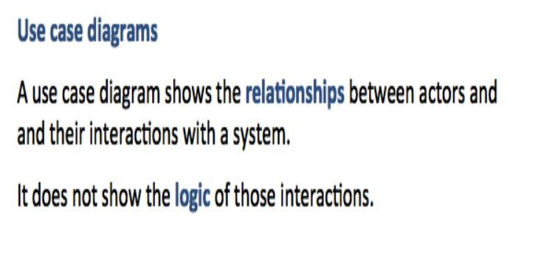
Use Case Diagrams
🞂
Software Engineering Concepts-CSC291-FALL-2022
Abbasi
Mr. Tehseen Riaz

Slide 91
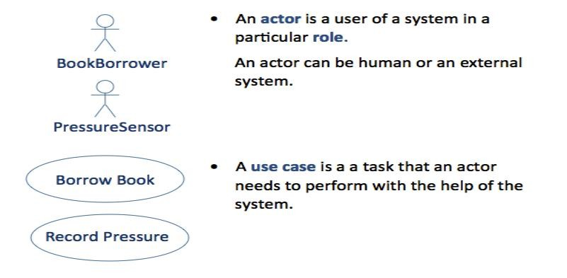
🞂​ Actors and Use Case Diagrams
Software Engineering Concepts-CSC291-FALL-2022
Abbasi
Mr. Tehseen Riaz

Slide 92
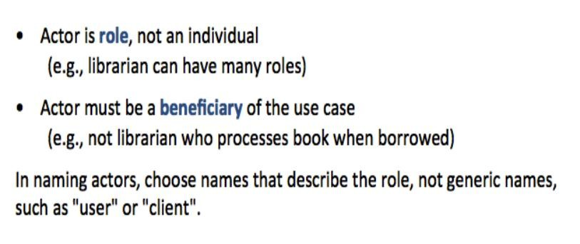
🞂​ Use Cases and Actors
Software Engineering Concepts-CSC291-FALL-2022
Abbasi
Mr. Tehseen Riaz

Slide 93
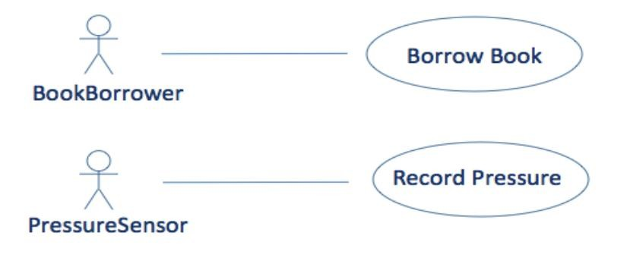
🞂​ Example: Two Simple Use Cases
Software Engineering Concepts-CSC291-FALL-2022
Abbasi
Mr. Tehseen Riaz

Slide 94
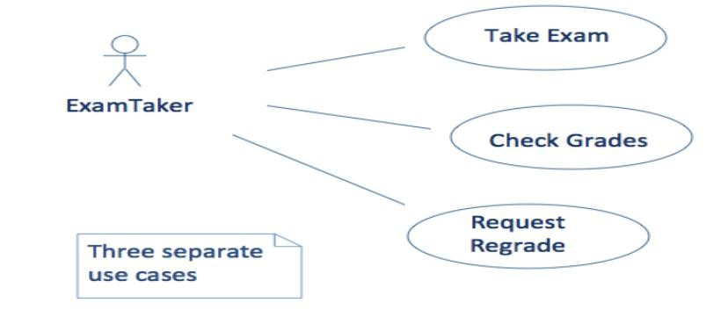
🞂​ Use Cases for Exam System
Software Engineering Concepts-CSC291-FALL-2022
Abbasi
Mr. Tehseen Riaz

Slide 95
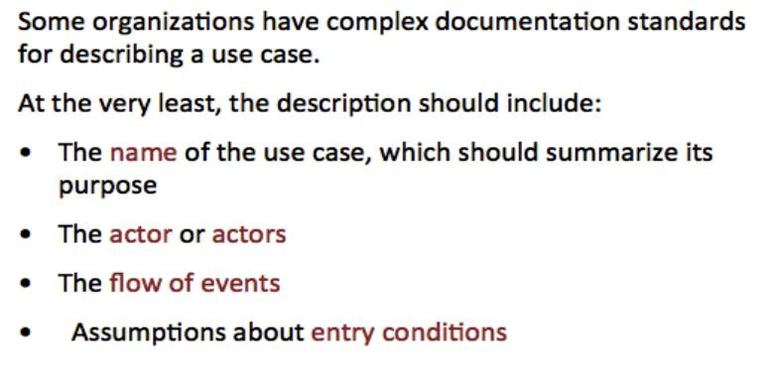
🞂​ Describing a Use Case
Software Engineering Concepts-CSC291-FALL-2022
Abbasi
Mr. Tehseen Riaz

Slide 96
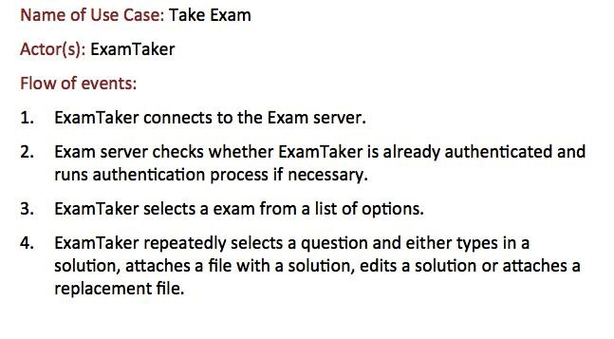
🞂​ Outline of Take Exam Use Case
Software Engineering Concepts-CSC291-FALL-2022
Abbasi
Mr. Tehseen Riaz

Slide 97
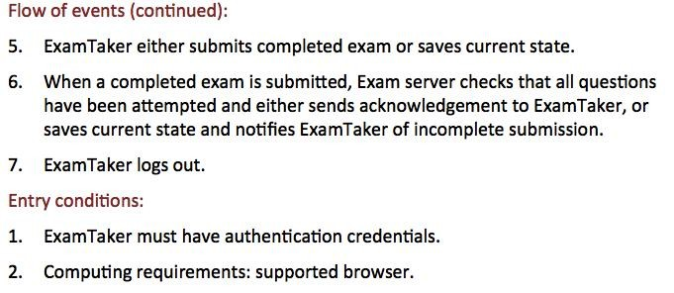
🞂​ Outline of Take Exam Use Case Cont.
Software Engineering Concepts-CSC291-FALL-2022
Abbasi
Mr. Tehseen Riaz

Slide 98
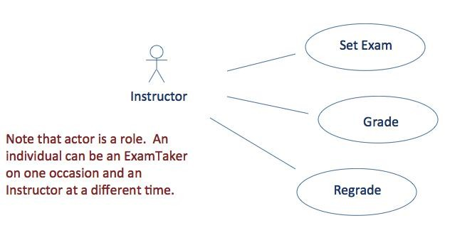
Take Exam Use Case Cont.
Software Engineering Concepts-CSC291-FALL-2022
Abbasi
Mr. Tehseen Riaz

Slide 99
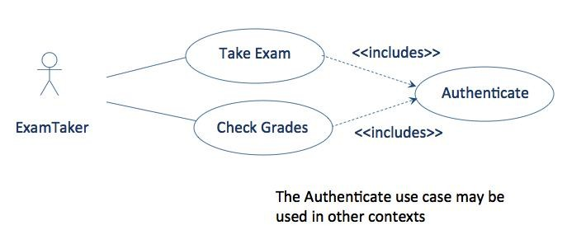
🞂​ Relationship Between Use Cases:
<<includes>>
Software Engineering Concepts-CSC291-FALL-2022
Abbasi
Mr. Tehseen Riaz

Slide 100
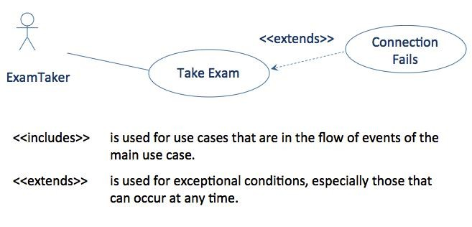
🞂​ Relationship Between Use Cases:
<<extends>>
Software Engineering Concepts-CSC291-FALL-2022
Abbasi
Mr. Tehseen Riaz

Slide 101
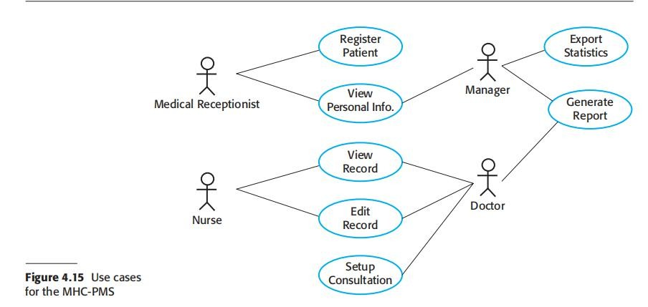
🞂​ Use cases for the MHC-PMS
Software Engineering Concepts-CSC291-FALL-2022
Mr. Tehseen Riaz Abbasi

Slide 102
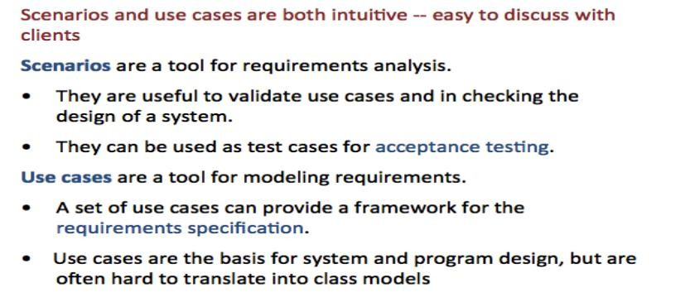
🞂​ Scenarios and Use Cases in Development
Cycle
Software Engineering Concepts-CSC291-FALL-2022
Abbasi
Mr. Tehseen Riaz

Slide 103
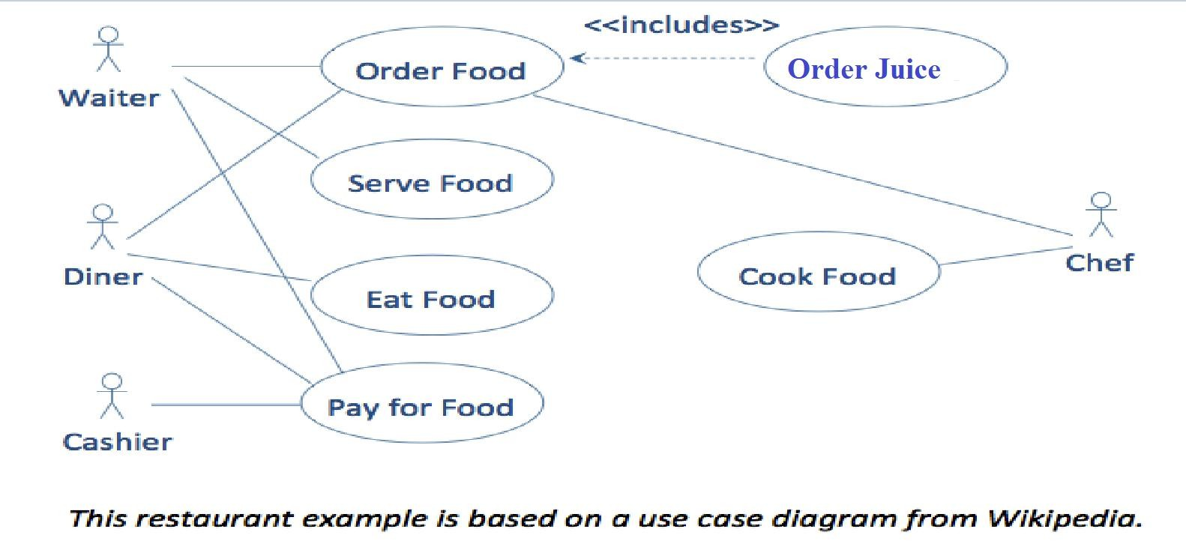
🞂​ Use Case with Several Actors
Software Engineering Concepts-CSC291-FALL-2022
Abbasi
Mr. Tehseen Riaz

Slide 104
🞂​ Use case approach
A use case describes a sequence of interactions between a system and an external actor that results in some outcome that provides value to the actor.
•
An actor is a person (or sometimes another software system or a
hardware device) that interacts with the system to perform a use case.
For example, the Chemical Tracking System’s “Request a Chemical” use case involves an actor named Requester.
There is no CTS user class named Requester.
Both chemists and members of the chemical stockroom staff may request chemicals, so members of either user class may perform the Requester role.

Slide 105
🞂​ Tabular Format and guideline to write use
case(s)
Use Case ID: | Enter a unique numeric identifier for the Use Case. e.g. UC-1.2.1
Use Case Name: | Enter a short name for the Use Case using an active verb phrase. e.g. Withdraw Cash
Actors: | [An actor is a person or other entity external to the software system being specified who interacts with the system and performs use cases to accomplish tasks. Different actors often correspond to different user classes, or roles, identified from the customer community that will use the product. Name the actor that will be initiating this use case (primary) and any other actors who will participate in completing the use case (secondary).]
Description: | [Provide a brief description of the reason for and outcome of this use case.]
Level: | Enter Use Case Goal Level here: High/Medium/Low
Trigger: | [Identify the event that initiates the use case. This could be an external business event or system event that causes the use case to begin, or it could be the first step in the normal flow.]

Slide 106
🞂​ Tabular Format and guideline to write use case(s)
Preconditions: | [List any activities that must take place, or any conditions that must be true, before the use case can be started. Number each pre-condition. e.g. Customer has active deposit account with ATM privileges Customer has an activated ATM card.]
Includes: | [List any other use cases that are included (“called”) by this use case. Common functionality that appears in multiple use cases can be split out into a separate use case that is included by the ones that need that common functionality. e.g. steps 1-4 in the normal flow would be required for all types of ATM transactions- a Use Case could be written for these steps and “included” in all ATM Use Cases.]

Slide 107
🞂​ Tabular Format and guideline to write use case(s)
Normal Flow:
[Provide a detailed description of the user actions and system responses that will take place during execution of the use case under normal, expected conditions. This dialog sequence will ultimately lead to accomplishing the goal stated in the use case name and description.
Customer inserts ATM card
Customer enters PIN
System prompts customer to enter language performance English or Spanish
System validates if customer is in the bank network
System prompts user to select transaction type
Customer selects Withdrawal From Checking
System prompts user to enter withdrawal amount
…
System ejects ATM card]

Slide 108
🞂​ Tabular Format and guideline to write use case(s)
_{Alternative Flows:} [Document legitimate branches from the main flow to handle special conditions (also
[Alternative Flow 1 – Not in Network]
known as extensions). For each alternative flow reference the branching step number of the normal flow and the condition which must be true in order for this extension to be executed.
e.g. Alternative flows in the Withdraw Cash transaction:
4a. In step 4 of the normal flow, if the customer is not in the bank network
System will prompt customer to accept network fee
Customer accepts
Use Case resumes on step 5
4b. In step 4 of the normal flow, if the customer is not in the bank network
System will prompt customer to accept network fee
Customer declines
Transaction is terminated
Use Case resumes on step 9 of normal flow
Note: Insert a new row for each distinctive alternative flow. ]
Software Engineering Concepts-CSC291-FALL-2022
Abbasi
Mr. Tehseen Riaz

Slide 109
🞂​ Tabular Format and guideline to write use case(s)
Exceptions: | [Describe any anticipated error conditions that could occur during execution of the use case, and define how the system is to respond to those conditions. e.g. Exceptions to the Withdraw Case transaction 2a. In step 2 of the normal flow, if the customer enters and invalid PIN Transaction is disapproved Message to customer to re-enter PIN Customer enters correct PIN Use Case resumes on step 3 of normal flow]
Post conditions: | [Describe the state of the system at the end of the use case execution. Should include both minimal guarantees (what must happen even if the actor’s goal is not achieved) and the success guarantees (what happens when the actor’s goal is achieved. Number each post- condition. e.g. Customer receives cash Customer account balance is reduced by the amount of the withdrawal and transaction fees]
Software Engineering Concepts-CSC291-FALL-2022
Abbasi
Mr. Tehseen Riaz

Slide 110
🞂​ Tabular Format and guideline to write use case(s)
S p e c i a l / Q u a l i t y Requirements (other information): | [Identify any additional requirements, such as nonfunctional requirements, for the use case that may need to be addressed during design or implementation. These may include performance requirements or other quality attributes.]
Assumptions: | [List any assumptions that were made in the analysis that led to accepting this use case into the product description and writing the use case description. e . g . F o r t h e Wi t h d r a w C a s h U s e C a s e , a n a s s u m p t i o n c o u l d b e : The Bank Customer understands either English or Spanish language.]
Business Rule: | Some business rules constrain which roles can perform all or parts of a use case. Perhaps only users who have certain privilege levels can perform specific alternative flows. That is, the rule might impose preconditions that the system must test before letting the user proceed. Business rules can influence specific steps in the normal flow by defining valid input values or dictating how computations are to be performed.

Slide 111
🞂​ Tabular Use Case Example-1
Use Case ID: | UC-1.1
Use Case Name: | Displaying Side Menu
Actors: | Dumb/deaf
Description: | In this use case, side menu will be displayed.
Trigger: | Clicking on side menu button will initiate the process.
Preconditions: | Side menu button should be pressed.
Post conditions: | Side menu will be displayed.
Normal Flow: | Opening the application. Clicking on the side menu button. Side menu will display.
Alternative Flows: | Opening the application. Swipe left to right on screen Side menu will display.
Exceptions: | In step 2 of normal flow if user click on right side of screen Side menu will disappear. Main interface will appear. In step 2 of normal flow if user swipe right to left Side menu will disappear. Main interface will appear.
Includes: | NA
Assumptions: | Application will be installed.
Notes and Issues: | NA

Slide 112
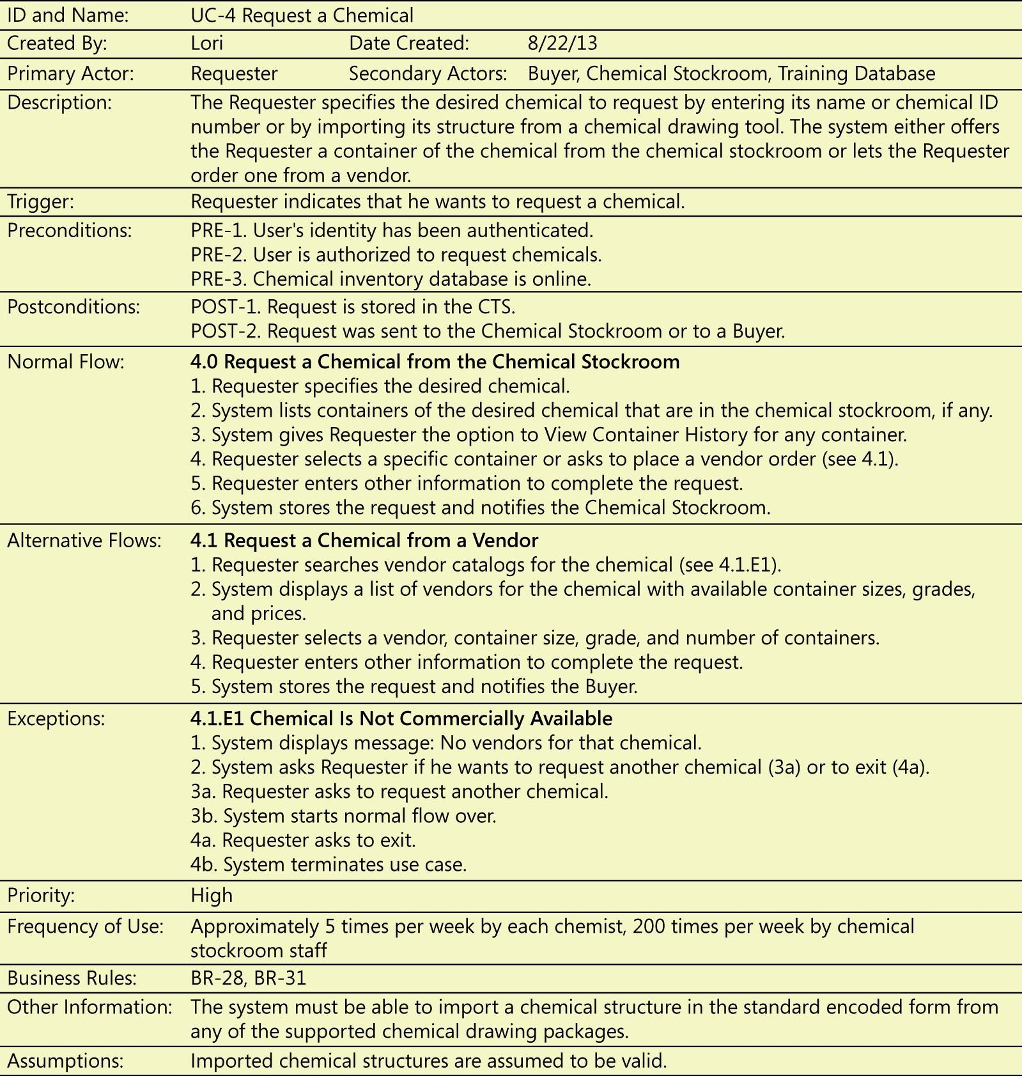
🞂​ Tabular Use Case Example-2

Slide 113
Template to write Functional Requirement
🞂
Identifier | Requirement ID
Title | Title of requirement
Requirement | Description of requirement
Source | Where requirement come from (who elicitate it)
Rationale | Motivation behind the requirement
Restrictions and Risk | Any restriction and risk that requirement must be fulfilled
Dependencies | Requirements ID that are dependent on this requirement
Priority | High/Medium/Low

Slide 114
🞂​ Functional Requirement – Example-1
Identifier | 1.2.1
Title | Edit Application
Requirement | The students must be able to access the main application tab so that they can edit their application and complete all the requirements of the application in order to apply to the universities they intends to
Source | Team Member
Rationale | To ensure that the student provides all the necessary details required
Restrictions and Risk | All the fields of the application have to be full filled in order to submit an application
Dependencies | 1.1.1
Priority | High

Slide 115
🞂​ Functional Requirement – Example-2
Table 8: Validate Email
Identifier | FR1.1.8
Title | Validate Email
Requirement | System will be able to validate email address entered by the user.
Source | Supervisor
Rationale | To inform the user if he/she enters an invalid email address
Business Rule (if required) | User must enter valid email address.
Dependencies | FR1.1.2
Priority | High

Slide 116
Functional Requirement – Example-3
Table 2: Perform Animation on Model
Identifier | FR-2.1.4
Title | Perform Animation on Model
Requirement | Baby model will perform the selected animation, which will be used to train the parents.
Source | Supervisor
Rationale | Baby’s model must perform the selected animation
Business Rule (if required) | N/A
Dependencies | N/A
Priority | High Software Engineering Concepts-CSC291-FALL-2022 Mr. Tehseen Riaz Abbasi

Slide 117
🞂​ Functional Requirement – Example-4
Identifier | 1.1.1
Title | Login/Register
Requirement | A student should be able to register and log in to the system
Source | Teacher
Rationale | Without login or registration the student cannot use the system
Restrictions and Risk | The student must remember the credentials and keep it safe
Dependencies | 1.1.2
Priority | High

Slide 118
Requirements Validation

Slide 119
🞂​ Requirements validation
examines the specification to ensure that all
Requirements validation
software requirements have been stated unambiguously; that inconsistencies, omissions, and errors have been detected and corrected; and that the work products conform to the standards established for the process, the project, and the product.
Concerned with demonstrating that the requirements define the system that the customer really wants.
Requirements error costs are high so validation is very important
Fixing a requirements error after delivery may cost up to 100 times the cost of fixing an implementation error.

Slide 120
🞂​ Requirements checking
Validity. Does the system provide the functions which best support the customer’s needs?
Consistency. Are there any requirements conflicts?
Completeness. Are all functions required by the customer included?
Realism. Can the requirements be implemented given available budget and technology
Verifiability. Can the requirements be checked?

Slide 121
🞂​ Requirements Validation Techniques
Requirements reviews
Systematic manual analysis of the requirements.
Prototyping
Using an executable model of the system to check requirements.
Test-case generation
Developing tests for requirements to check testability.

Slide 122
🞂​ Requirements Reviews
•
A requirements review is a process where a group of people from the system
customer and the system developer read the requirements document in detail
and check for errors, anomalies, and inconsistencies. Once these have been
detected and recorded, it is then up to the customer and the developer to
negotiate how the identified problems should be solved.
Regular reviews should be held while the requirements definition is being formulated.
Both client and contractor staff should be involved in reviews.
Reviews may be formal (with completed documents) or informal. Good communications between developers, customers and users can resolve problems at an early stage.

Slide 123
🞂​ Review checks
Verifiability
Is the requirement realistically testable?
Comprehensibility
Is the requirement properly understood?
Traceability
Is the origin of the requirement clearly stated?
Adaptability
Can the requirement be changed without a large impact on other requirements?

Slide 124
Requirements Management

Slide 125
🞂​ Requirements Management
Requirements management is the process of managing changing requirements during the requirements engineering process and system development.
New requirements emerge as a system is being developed and after it has gone into use.
You need to keep track of individual requirements and maintain links between dependent requirements so that you can assess the impact of requirements changes. You need to establish a formal process for making change proposals and linking these to system requirements.

Slide 126
🞂​ Requirements Change
The priority of requirements from different viewpoints changes during the development process.
System customers may specify requirements from a business perspective that conflict with end-user requirements.
The business and technical environment of the system changes during its development.

Slide 127
🞂​ Changing Requirements
The business and technical environment of the system always changes after installation.
New hardware may be introduced, it may be necessary to interface
the system with other systems, business priorities may change (with
consequent changes in the system support required), and new
legislation and regulations may be introduced that the system must necessarily abide by.
The people who pay for a system and the users of that system are rarely the same people.
System customers impose requirements because of organizational
and budgetary constraints. These may conflict with end-user
requirements and, after delivery, new features may have to be added for user support if the system is to meet its goals.

Slide 128
🞂​ Changing Requirements…
Large systems usually have a diverse user community, with many users having different requirements and priorities that may be conflicting or contradictory.
The final system requirements are inevitably a compromise between them and, with experience, it is often discovered that the balance of support given to different users has to be changed.

Slide 129
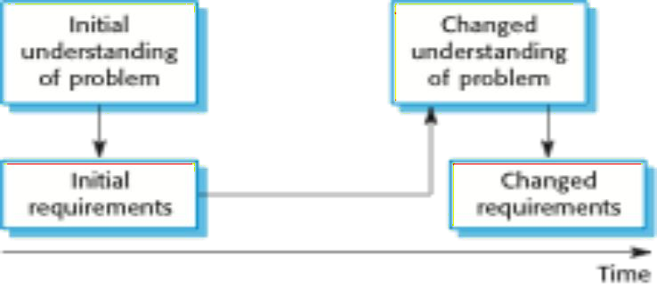
🞂​ Requirements evolution

Slide 130
🞂​ Requirements Management Planning
Establishes the level of requirements management detail that is required.
Requirements management decisions:
Requirements identification Each requirement must be uniquely identified so that it can be cross-referenced with other requirements.
A change management process This is the set of activities that assess
the impact and cost of changes. I discuss this process in more detail in the following section.
Traceability policies These policies define the relationships between
each requirement and between the requirements and the system design that should be recorded.
Tool support Tools that may be used range from specialist
requirements management systems to spreadsheets and simple database systems.

Slide 131
🞂​ Requirements Change Management
Deciding if a requirements change should be accepted
Problem analysis and change specification
During this stage, the problem or the change proposal is analyzed to
check that it is valid. This analysis is fed back to the change requester who may respond with a more specific requirements change proposal,
or decide to withdraw the request.
Change analysis and costing
The effect of the proposed change is assessed using traceability
information and general knowledge of the system requirements. Once
this analysis is completed, a decision is made whether or not to proceed with the requirements change.
Change implementation
The requirements document and, where necessary, the system design
and implementation, are modified. Ideally, the document should be organized so that changes can be easily implemented.

Slide 132
🞂​ Requirements Management Planning
During the requirements engineering process, you have to plan:
Requirements identification
How requirements are individually identified;
A change management process
The process followed when analyzing a requirements change;
Traceability policies
The amount of information about requirements relationships that is maintained;
CASE tool support
The tool support required to help manage requirements change;

Slide 133
🞂​ Traceability
Requirements traceability You need to keep track of the relationships between requirements, their sources, and the system design so that you can analyze the reasons for proposed changes and the impact that these changes are likely to have on other parts of the system.
Traceability is concerned with the relationships between requirements, their sources and the system design
Source traceability
Links from requirements to stakeholders who proposed these requirements;
Requirements traceability
Links between dependent requirements;
Design traceability
Links from the requirements to the design;

Slide 134
🞂​ A traceability matrix
Req. | 1.1 | 1.2 | 1.3 | 2.1 | 2.2 | 2.3 | 3.1 | 3.2
id
1.1 |  | D | R
1.2 |  |  | D |  |  | D |  | D
1.3 | R |  |  | R
2.1 |  |  | R |  | D |  |  | D
2.2 |  |  |  |  |  |  |  | D
2.3 |  | R |  | D
3.1 |  |  |  |  |  |  |  | R
3.2 |  |  |  |  |  |  | R

Slide 135
🞂​ CASE Tool Support
Requirements storage
Requirements should be managed in a secure, managed data store.
Change management
The process of change management is a workflow process whose stages can be defined and information flow between these stages partially automated.
Traceability management
Automated retrieval of the links between requirements.

Slide 136
🞂​ Requirements Change management
Should apply to all proposed changes to the requirements.
Principal stages
Problem analysis. Discuss requirements problem and propose change;
Change analysis and costing. Assess effects of change on other requirements;
Change implementation. Modify requirements document and other documents to reflect change.

Slide 137
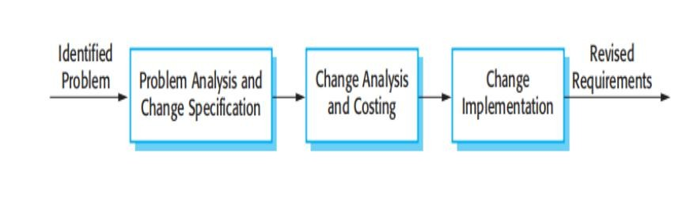
🞂​ Requirements Change Management

Slide 138
🞂​ Enduring and Volatile Requirements
Enduring requirements. Stable requirements derived from the core activity of the customer organization. E.g. a hospital will always have doctors, nurses, etc. May be derived from domain models
Volatile requirements. Requirements which change during development or when the system is in use. In a hospital, requirements derived from health-care policy

Slide 139
🞂​ Summary
The requirements engineering process includes a gathering, requirements elicitation and analysis, requirements specification and requirements management.
Requirements elicitation and analysis is iterative involving domain understanding, requirements collection, classification, structuring, prioritization and validation.
Systems have multiple stakeholders with different requirements.

Slide 140
🞂​ Summary
Requirements validation is concerned with checks for validity, consistency, completeness, realism and verifiability.
Business changes inevitably lead to changing requirements.
Requirements management includes planning and change management.

Slide 141
🞂​ Class TASK
Consider your watch as a system and set the time 2 minutes ahead. Write down each interaction between you and your watch as a scenario. Record all interactions, including any feedback the watch provides you

Slide 142
🞂​ Home Tasks
Draw a use case diagram for a ticket distributor for a train system.
The system includes two actors: a traveler who purchases different types of tickets, and a central computer system that maintains a reference database for the tariff.
Use cases should include
BuyOneWayTicket,
BuyWeeklyCard,
BuyMonthlyCard, and
UpdateTariff.
Also include the following exceptional cases:
TimeOut (i.e., traveler took too long to insert the right amount),
TransactionAborted (i.e., traveler selected the cancel button without completing the transaction),
DistributorOutOfChange, and
DistributorOutOfPaper

Slide 143

THANK YOU

Slide 144

THANK YOU

